Slide 1
Introduction to Data Structure and Algorithms
Azaz Ahmed Kiani

Slide 2
Algorithm Analysis
How Running Time is Estimated?

Slide 3
Solved Examples

Slide 4
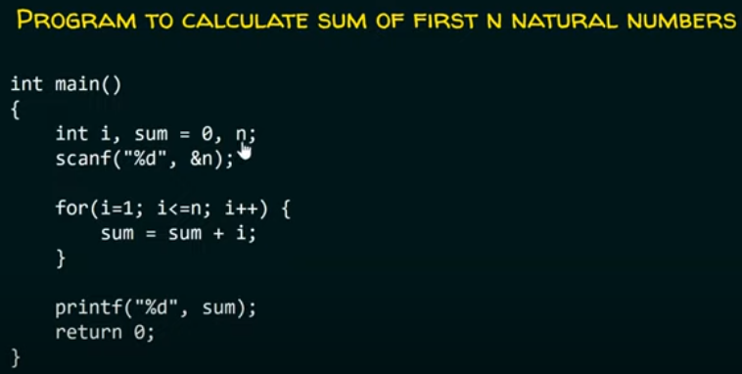
Problem: 1

Slide 5

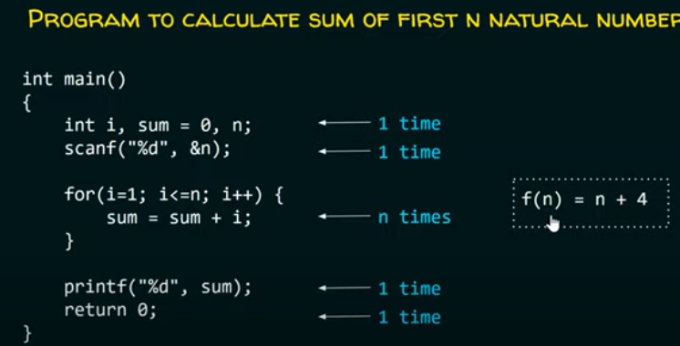
Solution: 1

Slide 6
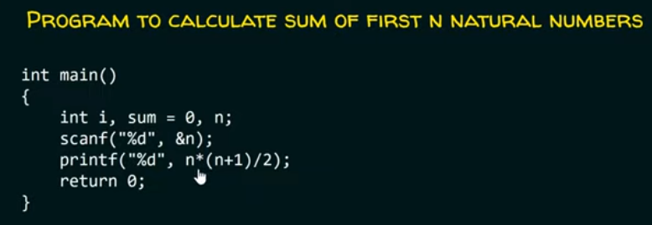
Problem: 2

Slide 7
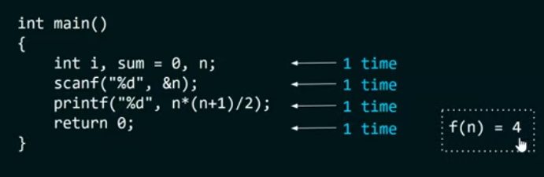
Solution: 2

Slide 8
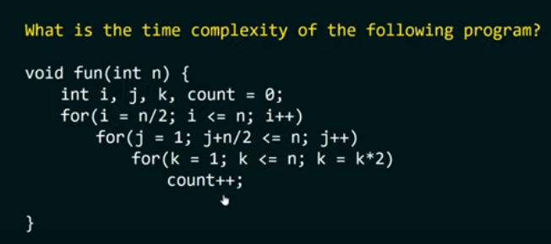
Problem: 3

Slide 9
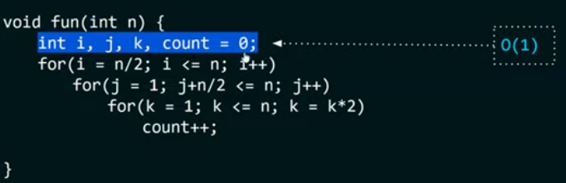
Solution 3 : Step 1

Slide 10
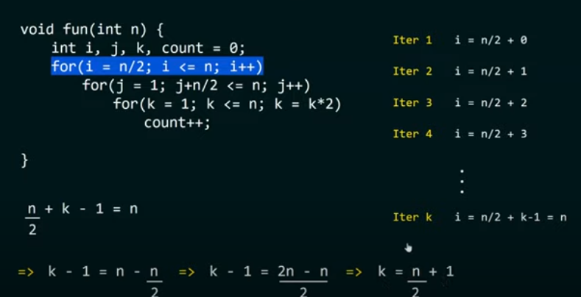
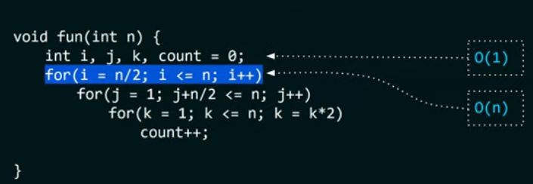
Solution3 : Step 2

Slide 11
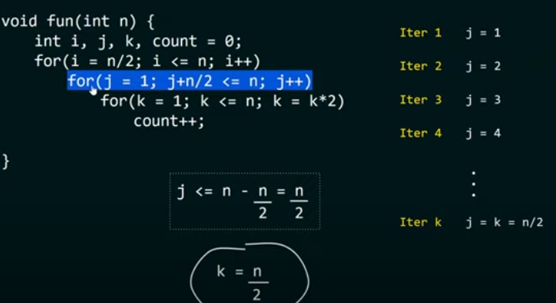
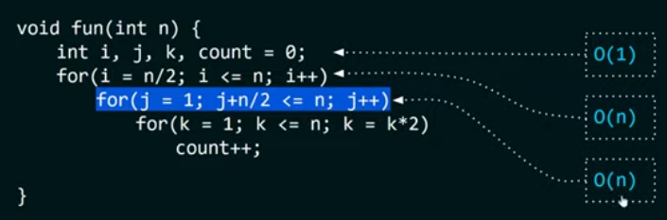
Solution3 : Step 3

Slide 12
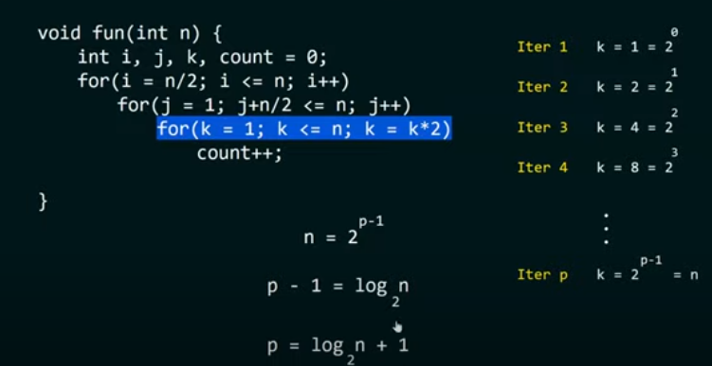
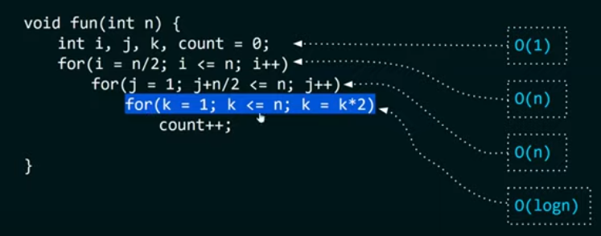
Solution 3 : Step 4

Slide 13
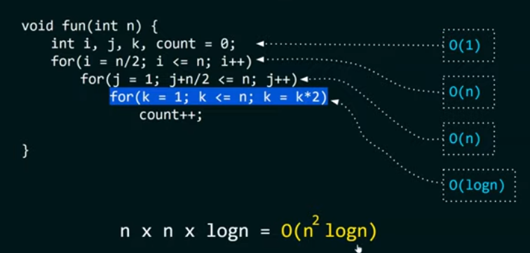
Overall complexity

Slide 14
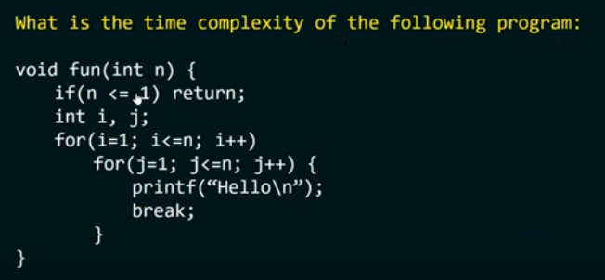

Problem:4

Slide 15
Space Complexity

Slide 16
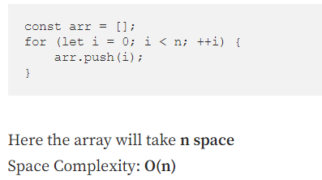
Problem 1:

Slide 17
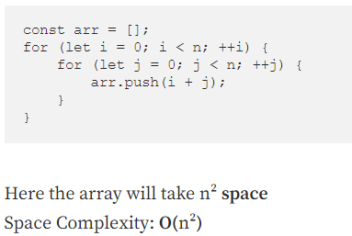
Problem: 2

Slide 18
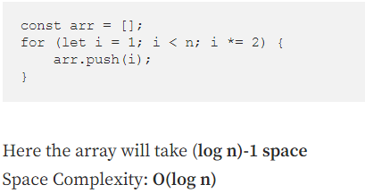
Problem: 3

Slide 19
Summary
Any Questions?

